Slide 1
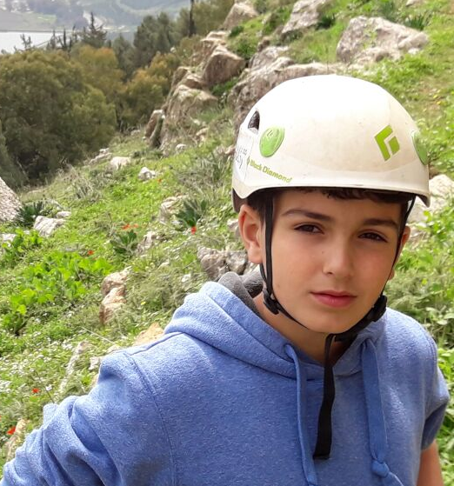
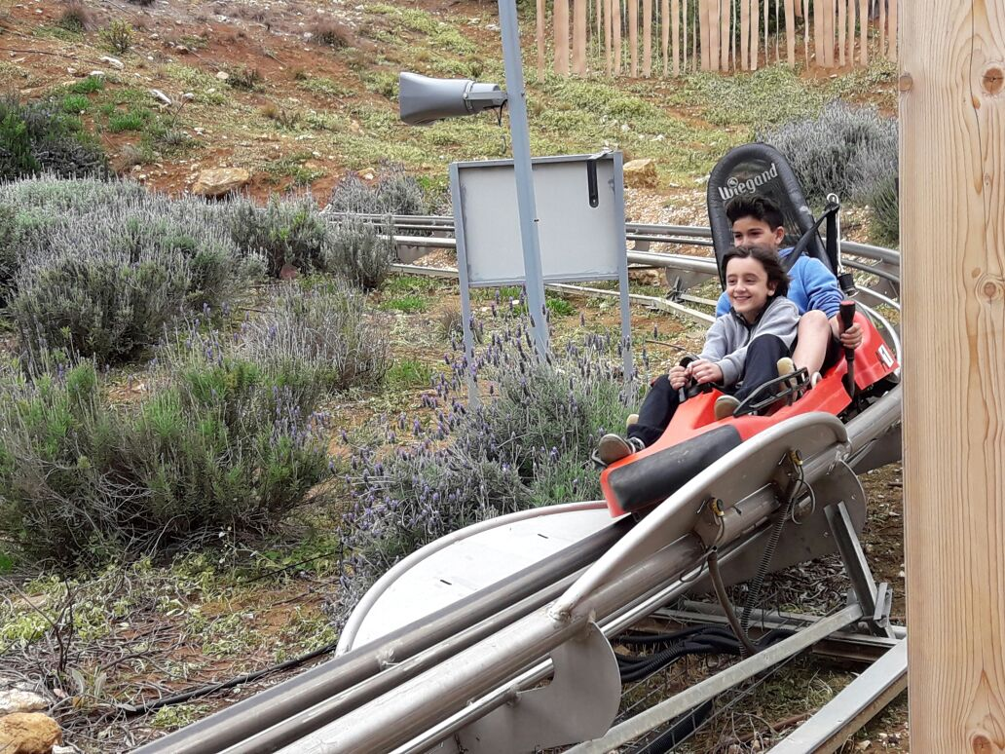
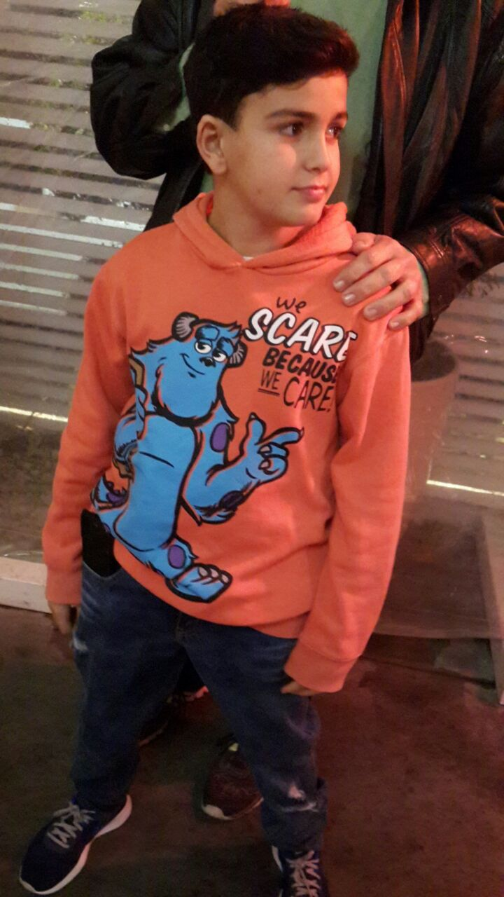
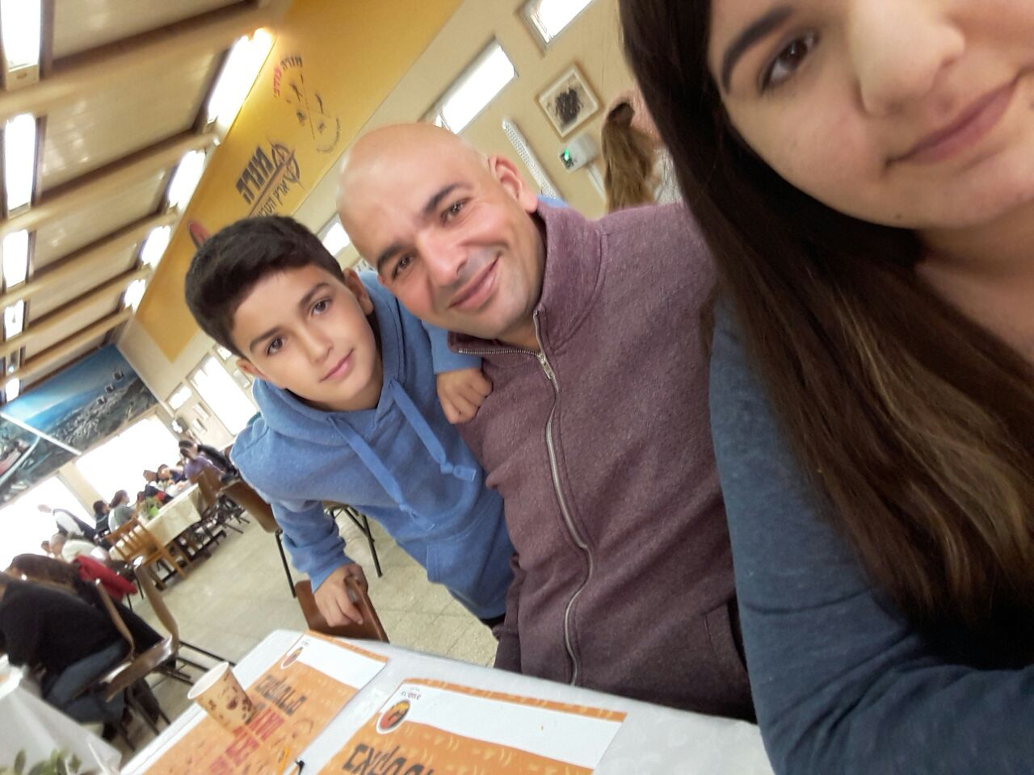
About myself
My name is Matan Tzur.
I am 12 years old.
I live in Alfei Menashe.
I am in the 7th grade.
There are 3 people in my family.
I am the youngest child in my family.
I have 1 sister.
My hair is brown.
I have brown eyes.
.I am a basketball player in Alfei Menashe
I don’t like to eat avocado.
I love to play basketball.
My favourite pet is a dog.
favourite song is-Happiness ExpressMy
My favourite movie is-wonder
My favourite book is Captain underwear

